Slide 1
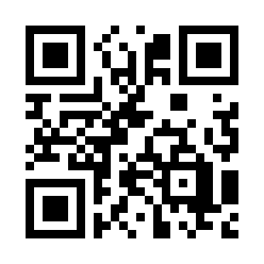

Software Team Management Quiz 02
https://bit.ly/3SZfjYT

